Slide 1
Neural Networks

Slide 2
Neural networks
Goal: Build an intuition into how neural networks works and get familiar with the associated vocabulary.
Program:
Intutiton to neural neworks
The anatomy of a network
The training process (gradient descent)
Backpropagation

Slide 3
Intuition

Slide 4
Neural Networks Intuition
Notes:
A biological neural network allows information from different sources to be combined and then sent to different parts of the network/brain.
The design of artificial neural networks was inspired by the biological counterpart.
Typically, in an artificial neural network information can only flow in one direction.

Slide 5
Anatomy of the network

Slide 6
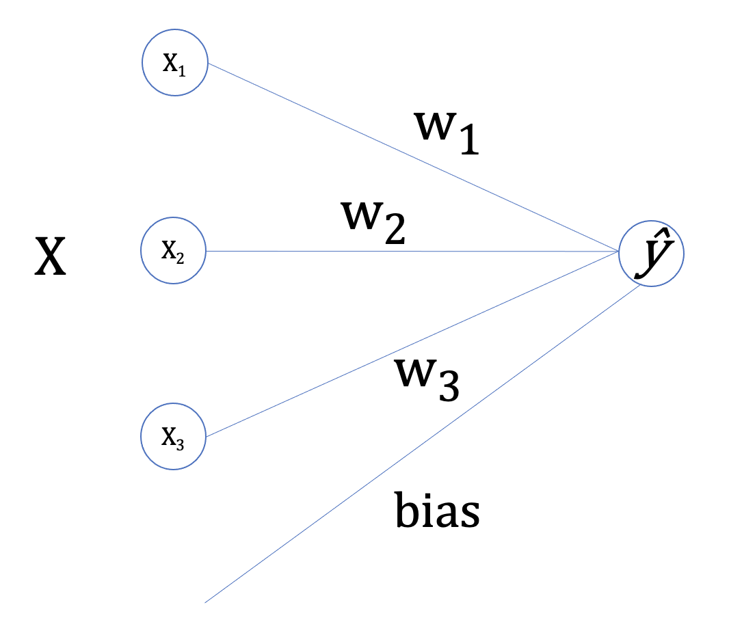
Anatomy of the network (neurons)
Inputs (vector x) are combined
with weights (vector w),
a bias (value b)
and a non-linear activation function (σ)
to produce an output value,
i.e. output = σ(𝑤^{𝑇}𝑥+𝑏)

Slide 7
Anatomy of the network (layers)
Layer: column of neurons stacked together that can receive the same inputs.
Hidden layer: intermediate layers between inputs and outputs.
Deep neural network: a neural network that contains many hidden layers, and can therefore provide solutions to more complicated and subtle decision problems.

Slide 8
The training process

Slide 9
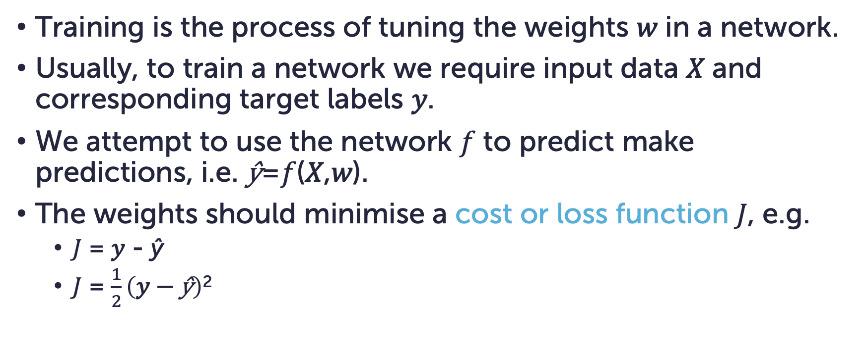
Training
Training is the process of tuning the weights 𝑤 in a network.
Usually, to train a network we require input data 𝑋 and corresponding target labels 𝑦.
We attempt to use the network 𝑓 to predict make predictions, i.e. ŷ=𝑓(𝑋,𝑤).
The weights should minimise a cost or loss function 𝐽, e.g.
𝐽 = 𝑦 - ŷ
𝐽 = $\frac{1}{2}\left(\text{y}\text{ − }\text{ŷ}\right)$²

Slide 10
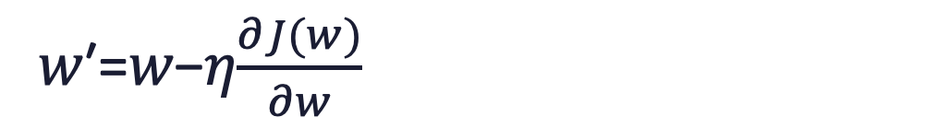
Gradient descent
𝑤′=𝑤−𝜂$\frac{∂J(w)}{∂w}$
A process of following the gradients of the error function towards a minimum value.

Slide 11
Backpropogation

Slide 12
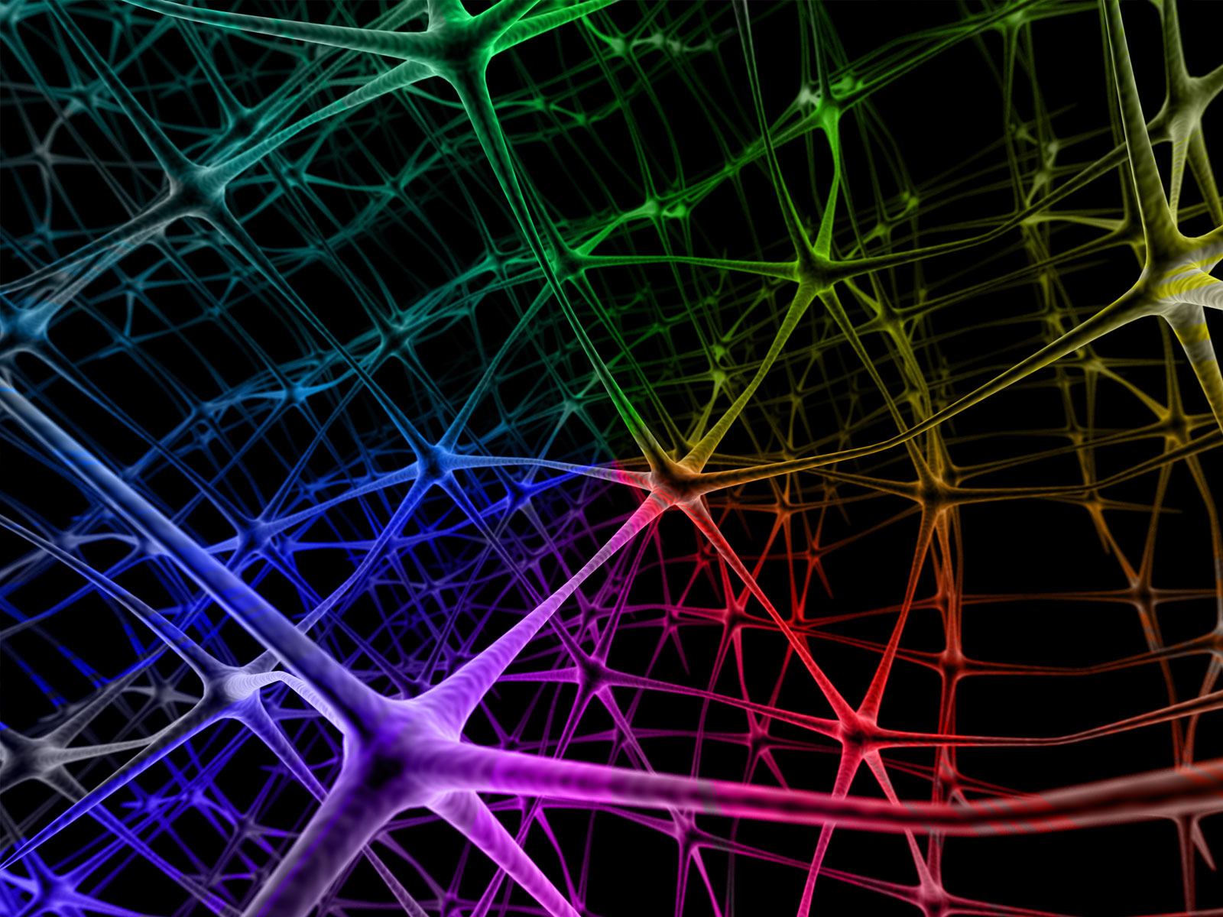
Backpropagation
We'll now examine backpropagation, a fast algorithm for computing the weight gradients which is based on the chain-rule.
This Photo by Unknown Author is licensed under CC BY-NC-ND

Slide 13
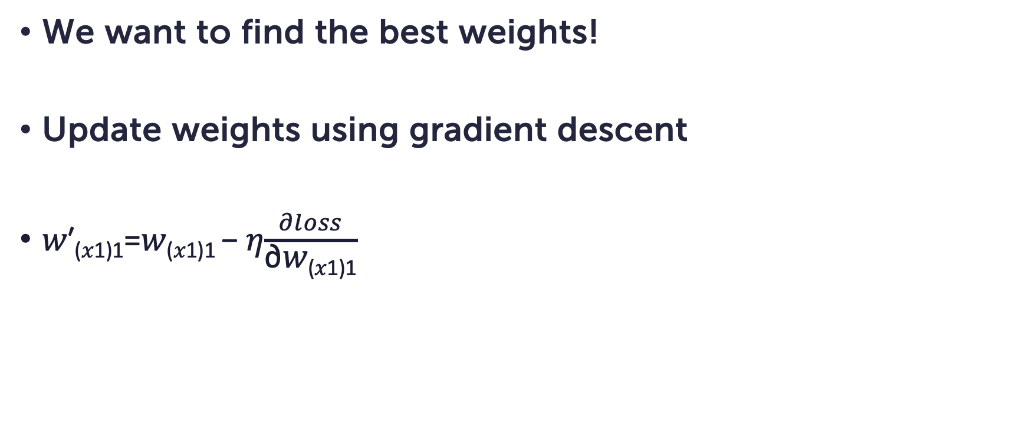
Weight updates
We want to find the best weights!
Update weights using gradient descent
𝑤′_{(𝑥1)1}=𝑤_{(𝑥1)1} − 𝜂$\frac{∂loss}{\text{∂}\text{w}\text{(}\text{x}\text{1)1}}$
^

Slide 14
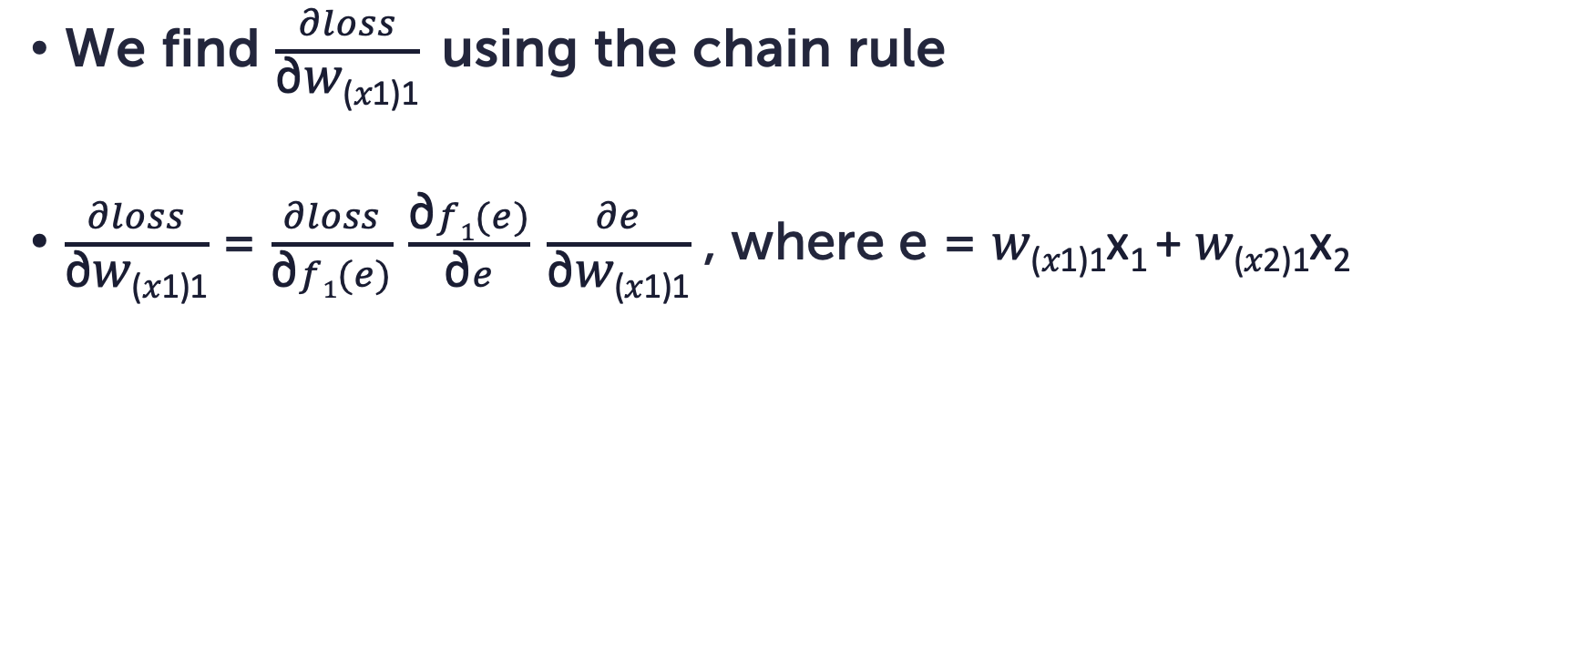
Weight updates
We find $\frac{∂loss}{\text{∂}\text{w}\text{(}\text{x}\text{1)1}}$ using the chain rule
$\frac{∂loss}{\text{∂}\text{w}\text{(}\text{x}\text{1)1}}$ = $\frac{∂loss}{\text{∂}f1(e)} \frac{\text{∂}f1(e)}{\text{∂}e} \frac{∂e}{\text{∂}\text{w}\text{(}\text{x}\text{1)1}}$ , where e = $\text{w}\text{(}\text{x}\text{1)1}\text{x}\text{1 }\text{+ }\text{w}\text{(}\text{x}\text{2}\text{)1}\text{x}\text{2}$
We need to compute
these gradients
^

Slide 15
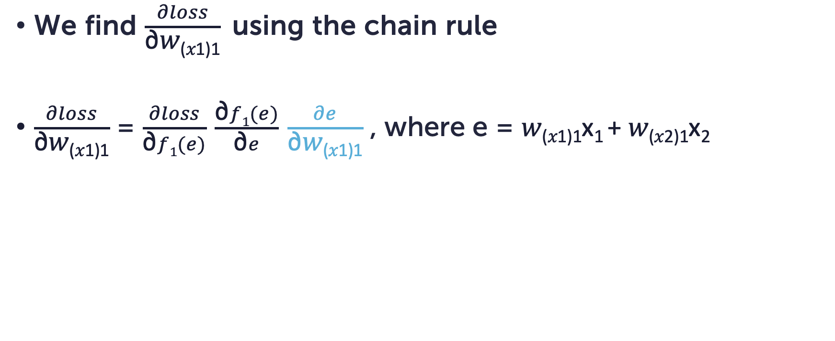
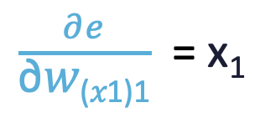
Weight updates
We find $\frac{∂loss}{\text{∂}\text{w}\text{(}\text{x}\text{1)1}}$ using the chain rule
$\frac{∂loss}{\text{∂}\text{w}\text{(}\text{x}\text{1)1}}$ = $\frac{∂loss}{\text{∂}f1(e)} \frac{\text{∂}f1(e)}{\text{∂}e} \frac{∂e}{\text{∂}\text{w}\text{(}\text{x}\text{1)1}}$ , where e = $\text{w}\text{(}\text{x}\text{1)1}\text{x}\text{1 }\text{+ }\text{w}\text{(}\text{x}\text{2}\text{)1}\text{x}\text{2}$
We need to compute
these gradients
^
$\frac{∂e}{\text{∂}\text{w}\text{(}\text{x}\text{1)1}}$ = $\text{x}\text{1}$

Slide 16
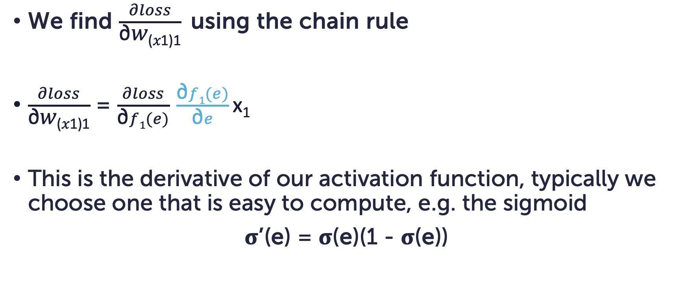
Weight updates
We find $\frac{∂loss}{\text{∂}\text{w}\text{(}\text{x}\text{1)1}}$ using the chain rule
$\frac{∂loss}{\text{∂}\text{w}\text{(}\text{x}\text{1)1}}$ = $\frac{∂loss}{\text{∂}f1(e)} \frac{\text{∂}f1(e)}{\text{∂}e}\text{x}\text{1}$
This is the derivative of our activation function, typically we choose one that is easy to compute, e.g. the sigmoid
σ’(e) = σ(e)(1 - σ(e))
We need to compute
these gradients

Slide 17
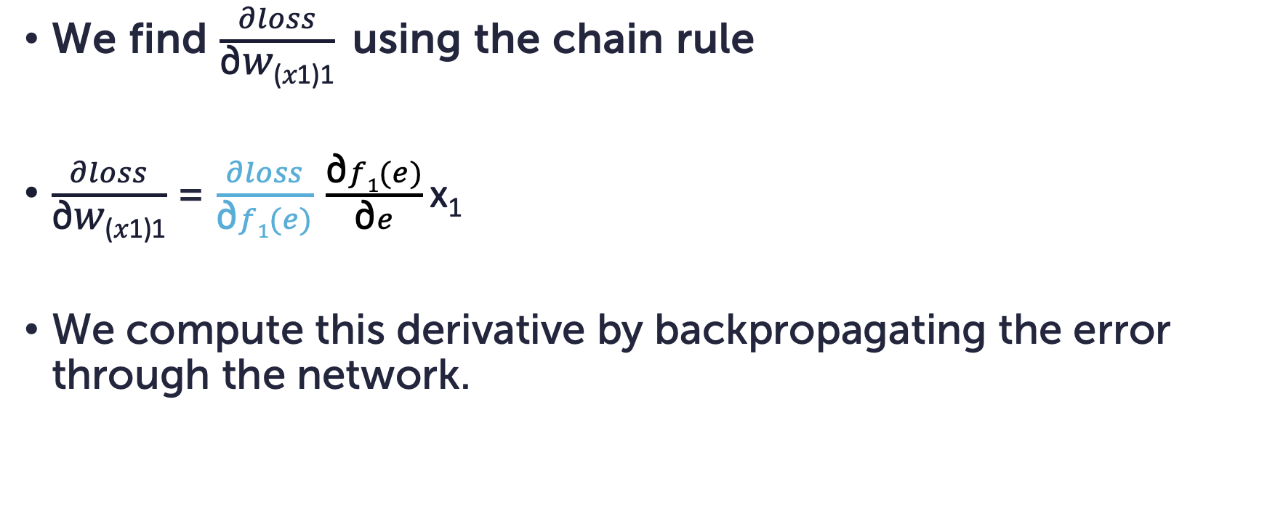
Weight updates
We find $\frac{∂loss}{\text{∂}\text{w}\text{(}\text{x}\text{1)1}}$ using the chain rule
$\frac{∂loss}{\text{∂}\text{w}\text{(}\text{x}\text{1)1}}$ = $\frac{∂loss}{\text{∂}f1(e)} \frac{\text{∂}f1(e)}{\text{∂}e}\text{x}\text{1}$
We compute this derivative by backpropagating the error through the network.
We need to compute
these gradients

Slide 18
Epoch
ŷ
Forward pass: a data sample is passed forward through the network to determine a prediction.
Backward pass: recursively compute the error backwards from the last layer following the chain-rule and update the weights w.r.t. the known target output.
Epoch: training the neural network with all the training data for one cycle.
Notes:
Requirement: all elements of the neural network should be differentiable

Slide 19
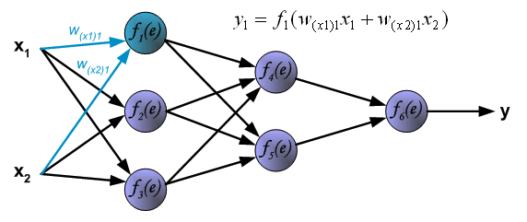
Forward pass
Feed data through the network.
^
ŷ

Slide 20
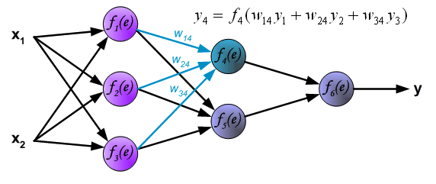
Forward pass
Feed data through the network.
^
ŷ

Slide 21
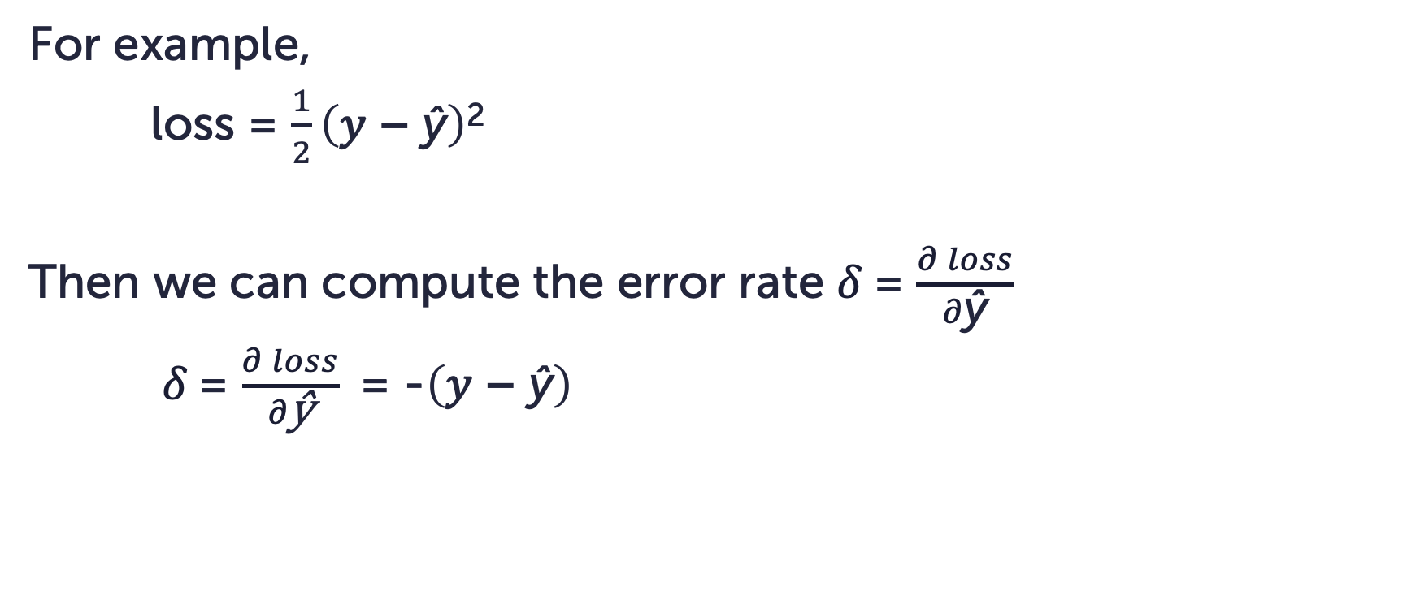
Compute the error
For example,
loss = $\frac{1}{2}\left(\text{y}\text{ − }\text{ŷ}\right)$²
Then we can compute the error rate 𝛿 = $\frac{∂ loss}{∂\text{ŷ}}$
𝛿 = $\frac{∂ loss}{∂\text{ŷ}}$ = -$\left(\text{y}\text{ − }\text{ŷ}\right)$

Slide 22
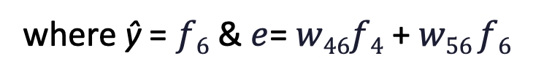
Backpropgation
Local error contribution
𝛿₄= $\frac{∂ loss}{∂f4}$ = $\frac{∂ loss}{∂f6}\frac{∂f6(e)}{∂\text{e}}\frac{∂\text{e}}{∂f4}$ = 𝛿 $\frac{∂f6(e)}{∂\text{e}}w4$
where $\text{ŷ}$ = $f6$ & $e$= $w46f4$ + $w56 f6$
ŷ

Slide 23
Backpropgation
Local error contribution
𝛿₁= $\frac{∂ loss}{∂f1}$ = $\frac{∂ loss}{∂\text{ŷ}}$ $\frac{∂\text{ŷ}}{∂\text{e}}\frac{∂\text{e}}{∂f4}$ = 𝛿₄ $\frac{∂f4(e)}{∂\text{e}}w14$+ 𝛿₅ $\frac{∂f5(e)}{∂\text{e}}w15$
ŷ

Slide 24
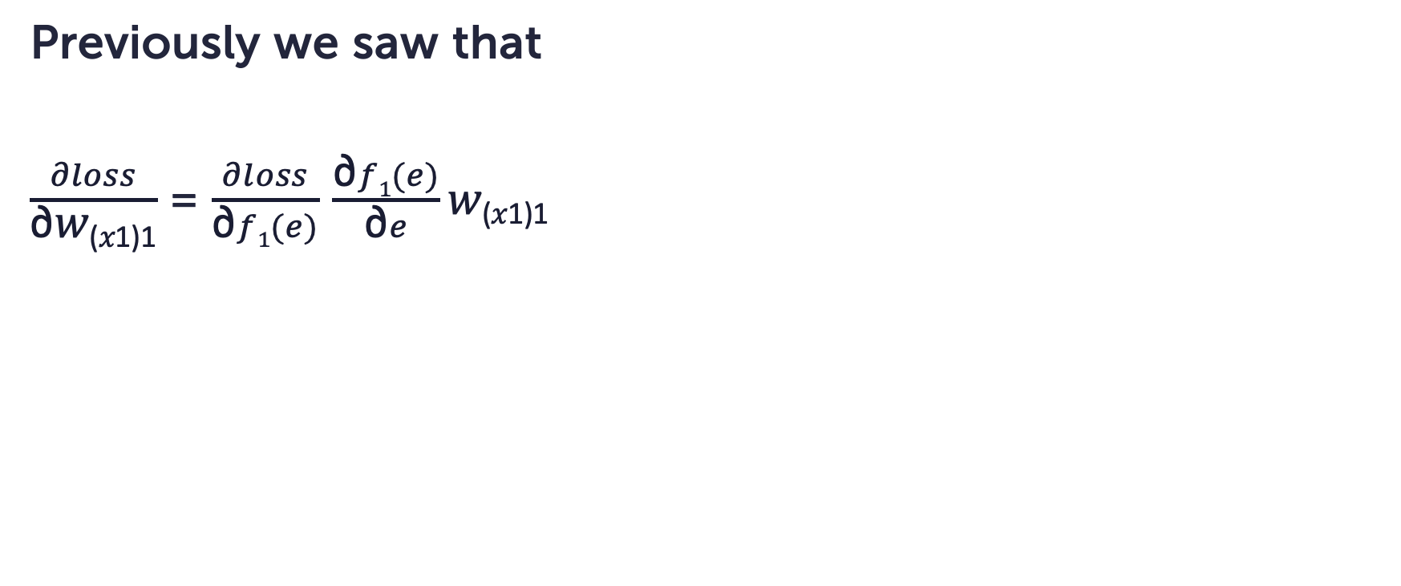
Backpropagation
Previously we saw that
$\frac{∂loss}{\text{∂}\text{w}\text{(}\text{x}\text{1)1}}$ = $\frac{∂loss}{\text{∂}f1(e)} \frac{\text{∂}f1(e)}{\text{∂}e}\text{w}\text{(}\text{x}\text{1)1}$
^

Slide 25
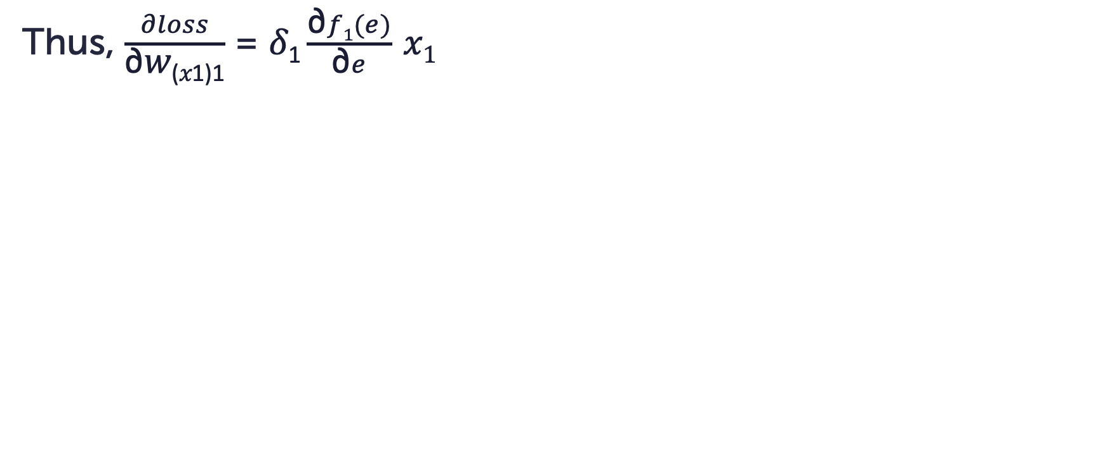
Backpropagation
Thus, $\frac{∂loss}{\text{∂}\text{w}\text{(}\text{x}\text{1)1}}$ = $\text{δ}\text{1}\frac{\text{∂}f1(e)}{\text{∂}e} x1$
^

Slide 26
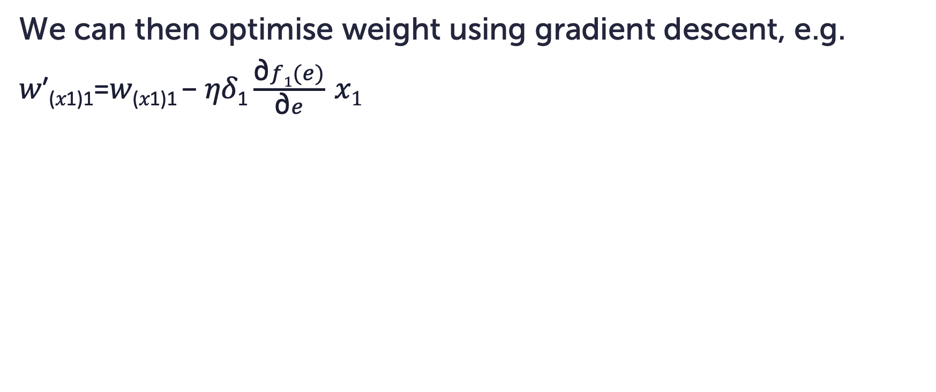
Backpropagation
We can then optimise weight using gradient descent, e.g.
𝑤′_{(𝑥1)1}=𝑤_{(𝑥1)1} − 𝜂$\text{δ}\text{1}\frac{\text{∂}f1(e)}{\text{∂}e} x1$

Slide 27
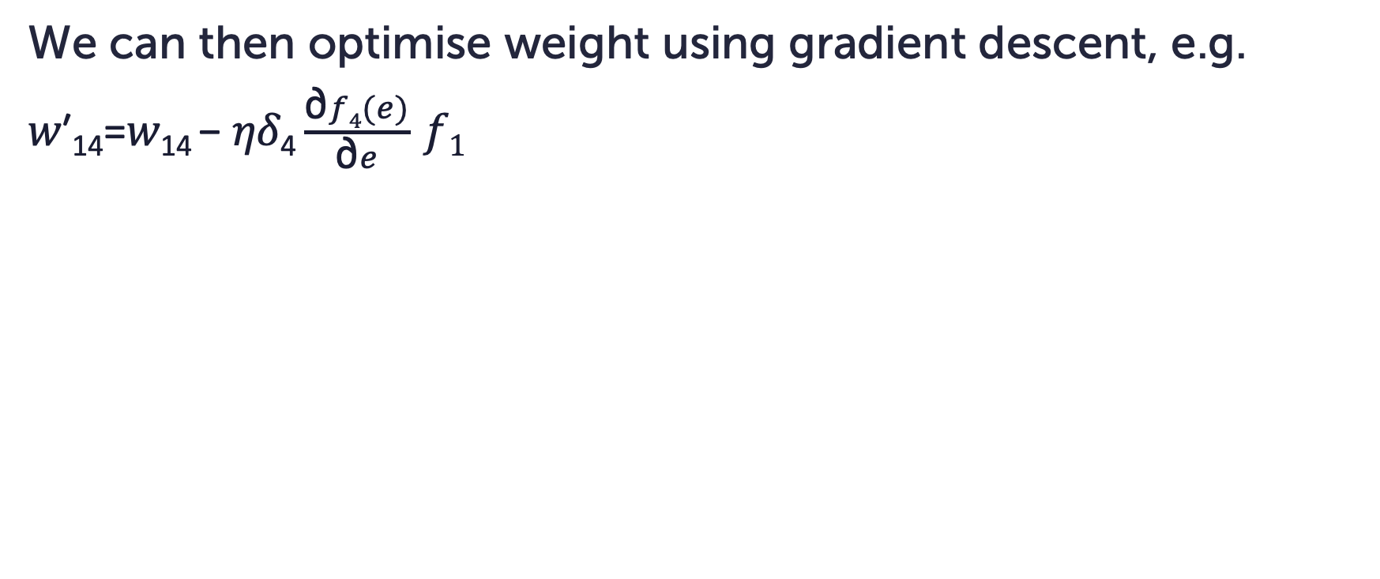
Backpropagation
We can then optimise weight using gradient descent, e.g.
𝑤′₁₄=𝑤₁₄ − 𝜂$\text{δ}\text{4}\frac{\text{∂}f4(e)}{\text{∂}e} f1$
^
^
^

Slide 28
Summary

Slide 29
Summary
In this section we have covered
Intutiton to neural neworks
The anatomy of a network
The training process (gradient descent)
Backpropagation
In the next exercise we will build a MLP to solve the XOR problem

Slide 30
XOR perceptron

Slide 31
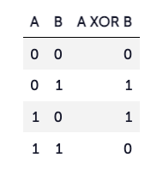
XOR
A XOR gate (or exclusive OR) is a logic gate that returns true (or 1) when one, and only one, of the inputs of the gate is true. Otherwise it returns false.
Whereas other logical operators (such as AND and OR) can be modeled with a single layer perceptron, the XOR operator is more complex and must be modeled with a multi-layer perceptron.

Slide 32
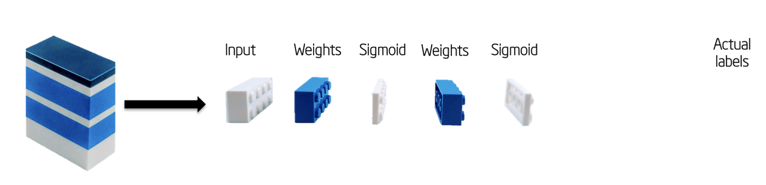
MLP
The MLP applies layers of transformations to our input. We compare the output of the model to our actual labels.
The next slide shows a schematic diagram of the MLP we will be creating

Slide 33
w₁
w₇
w₂
w₃
w₈
X
ŷ
y
w₄
w₅
w₉
w₆

Slide 34
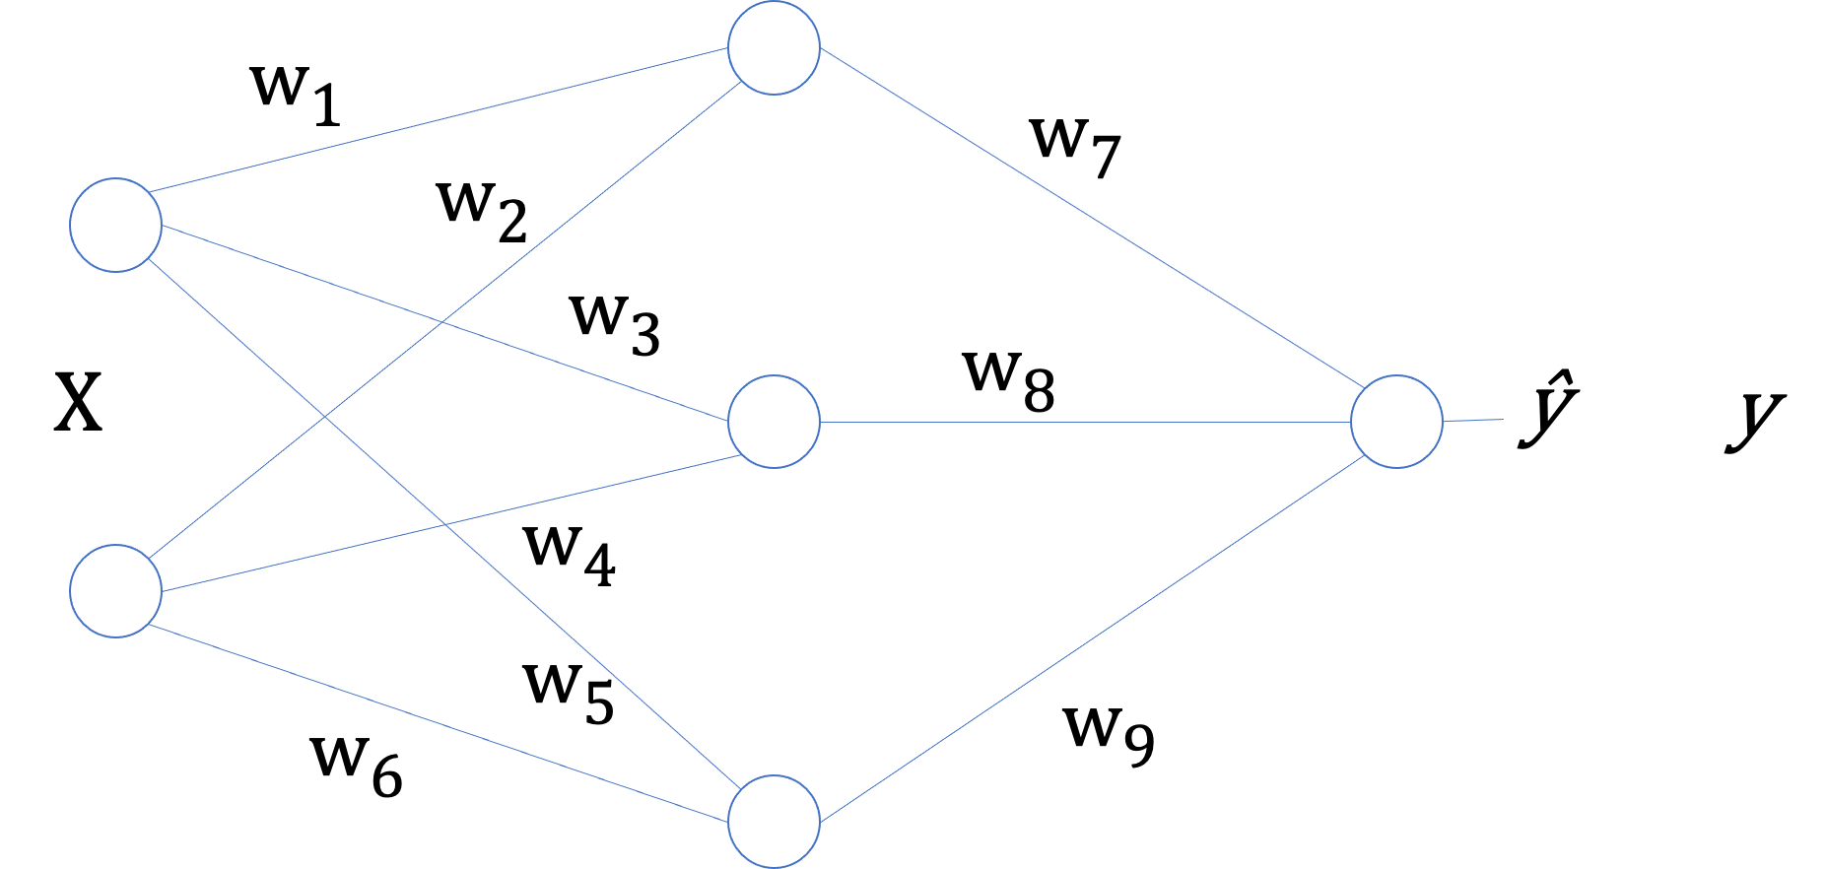
XOR MLP
w₇
w₈
w₉
w₁ | w₃ | w₂
w₂ | w₄ | w₆
X₁ | X₂
.
h₁ | h₂ | h₃
ŷ
y

Slide 35
Questions?

